Slide 1
Chongqing University of Technology
ATAI
Advanced Technique of Artificial Intelligence
Chongqing University of Technology
https://github.com/thu-coai/HINT
彭展望

Slide 2
Outline
Introduction
Related Work
Method
Experiment
Conclusion

Slide 3
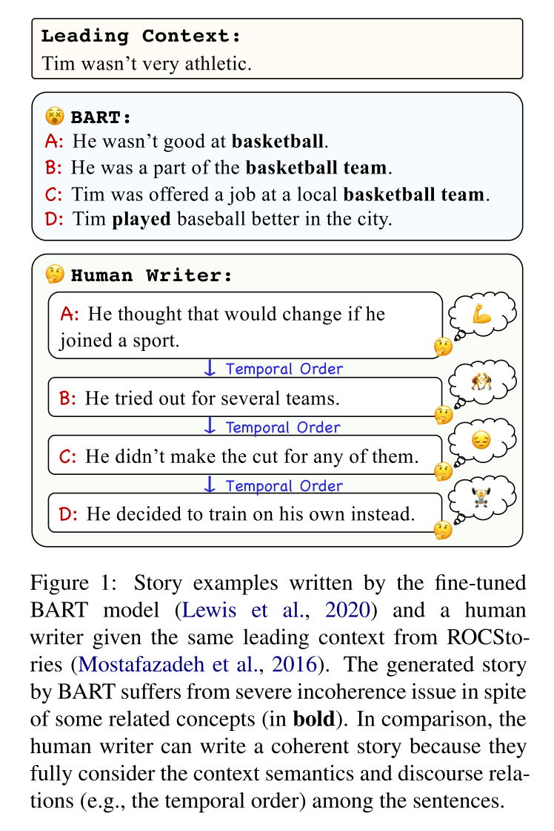
Introduction

Slide 4
Task Definition:
given an input：
generate a multi-sentence text:
each $x_{i}$ or $y_{i}$ is a token
Notes:
Previous work

Slide 5
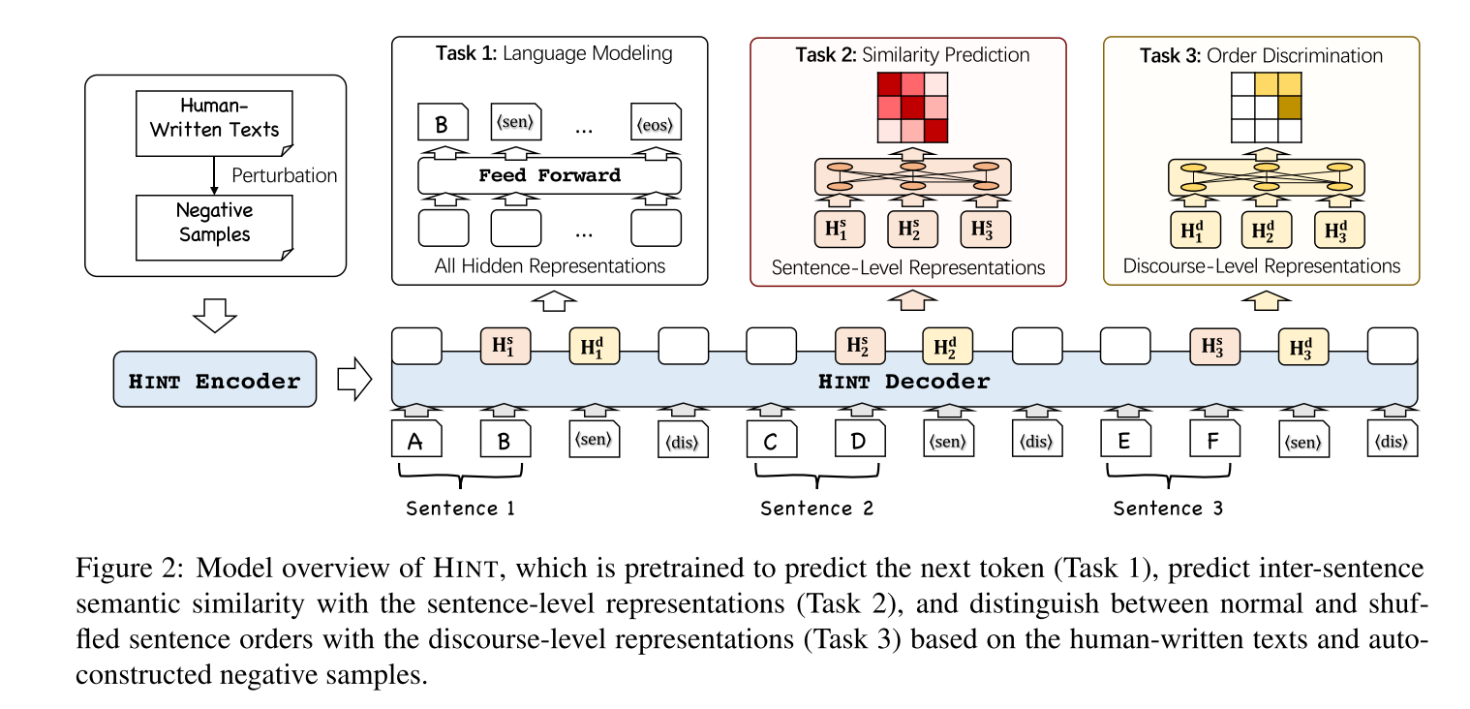
Method

Slide 6
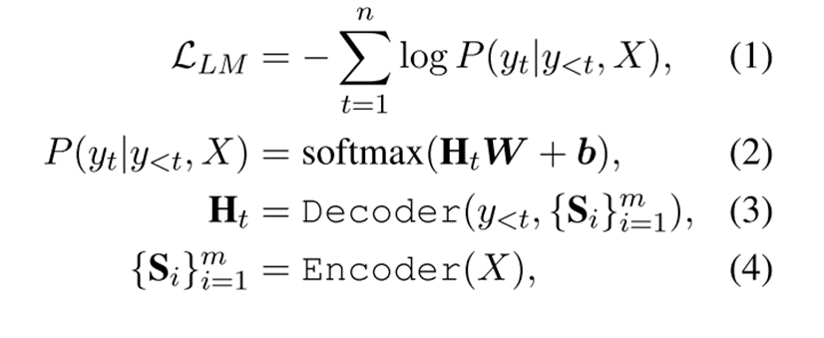
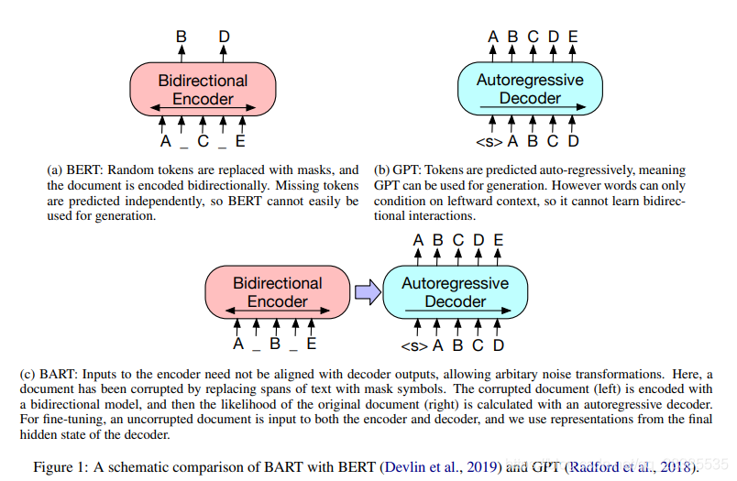
Method
Task 1:
BART: denoising sequence-to-sequence pretraining for natural language generation, translation, and comprehension (ACL 2020)
Notes:
Task 1:

Slide 7
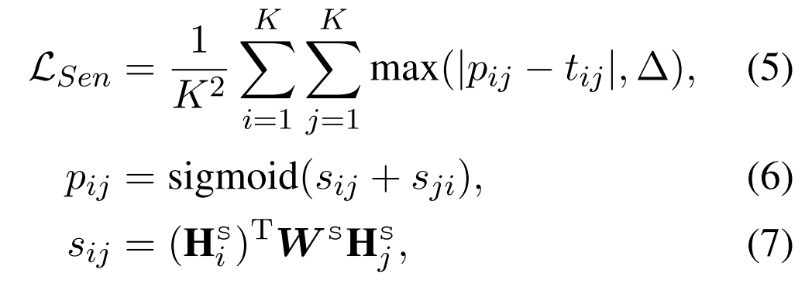
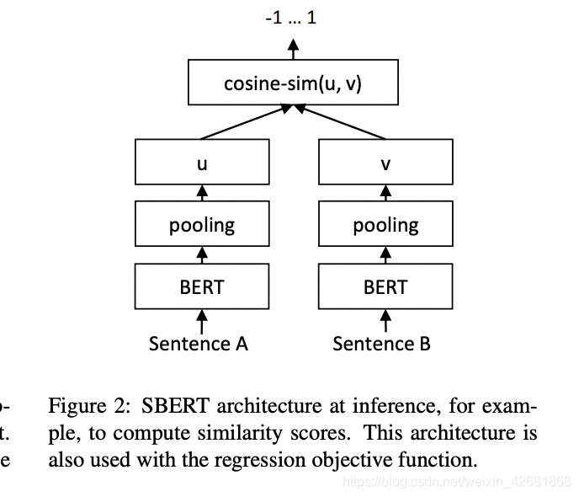
Method
$Task$ 2:
Sentence-bert: Sentence embeddings using Siamese bert-networks. (EMNLP 2019)
Sentence-bert
$t_{ij}$ is the golden similarity
Notes:
$Task$2

Slide 8
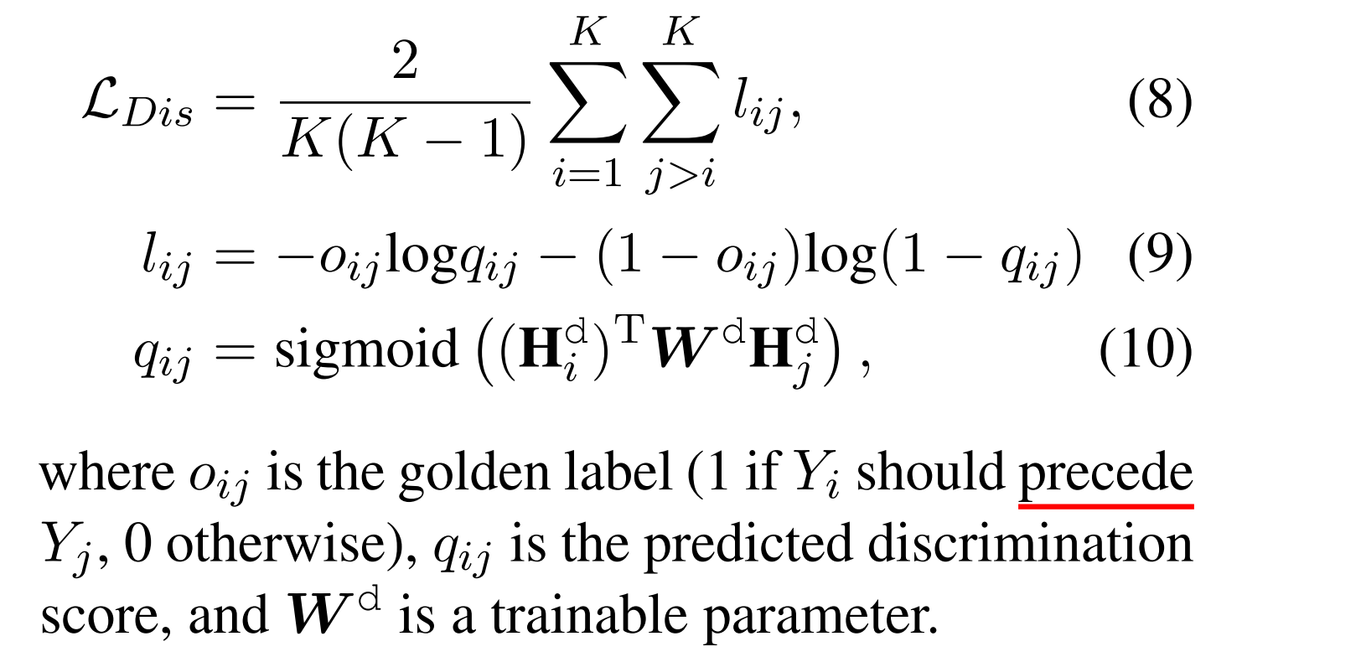
Method
Task 3:
Notes:
Task 3:

Slide 9
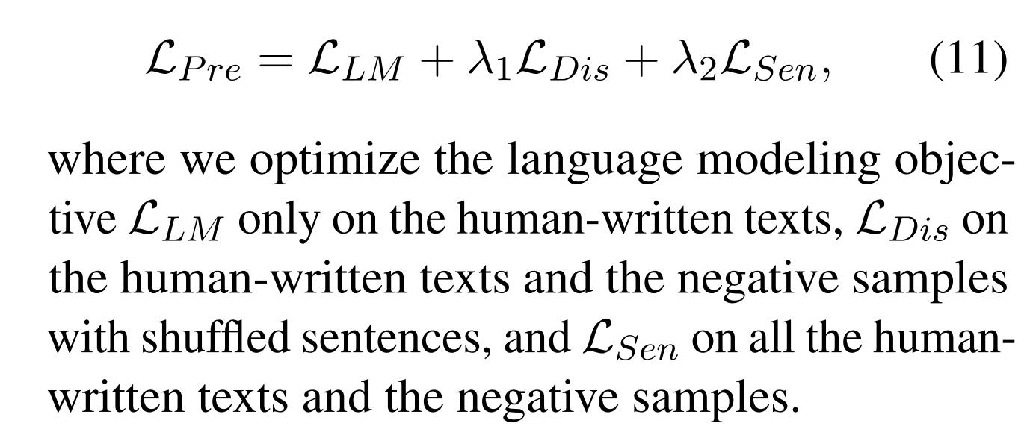
Method

Slide 10
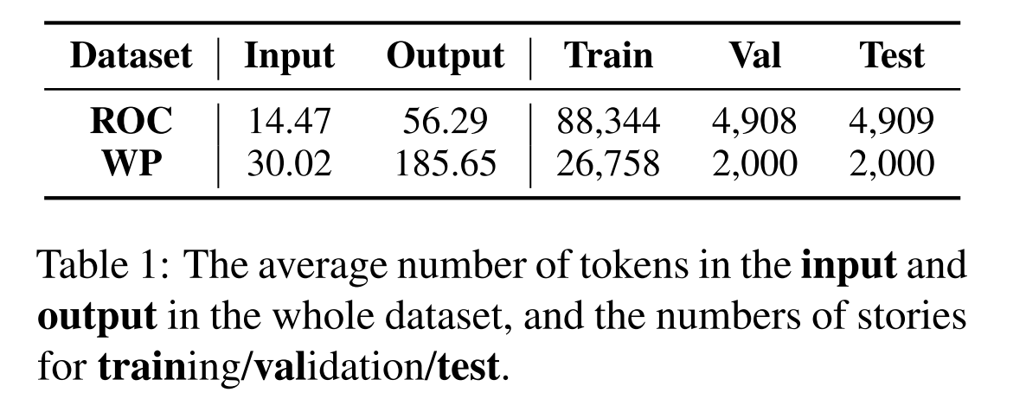
Dataset

Slide 11
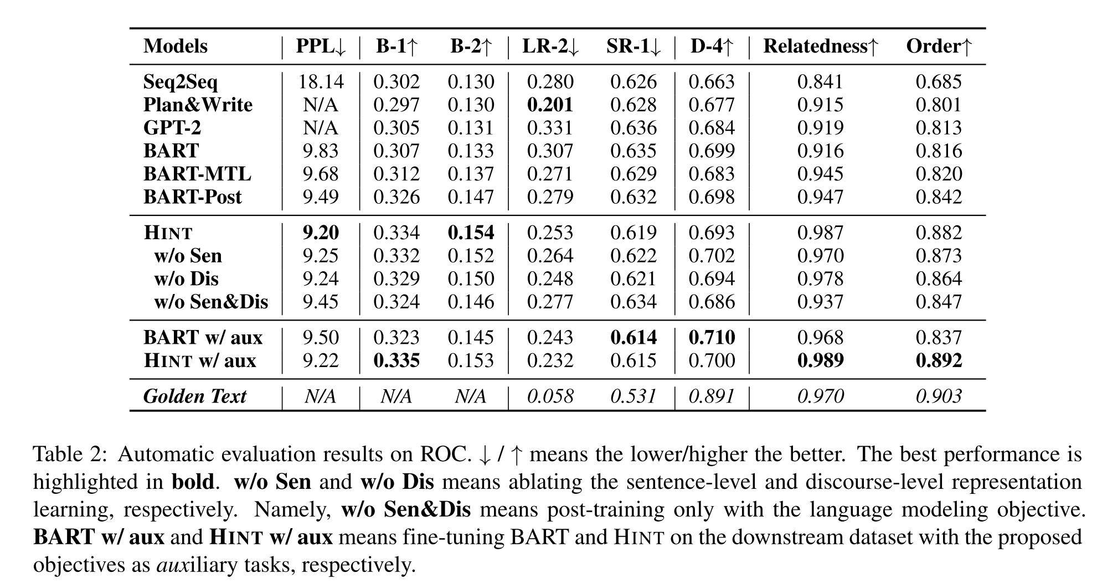
Experiment
UNION: an unreferenced metric for evaluating open-ended story generation.（EMNLP 2020）Relatedness

Slide 12
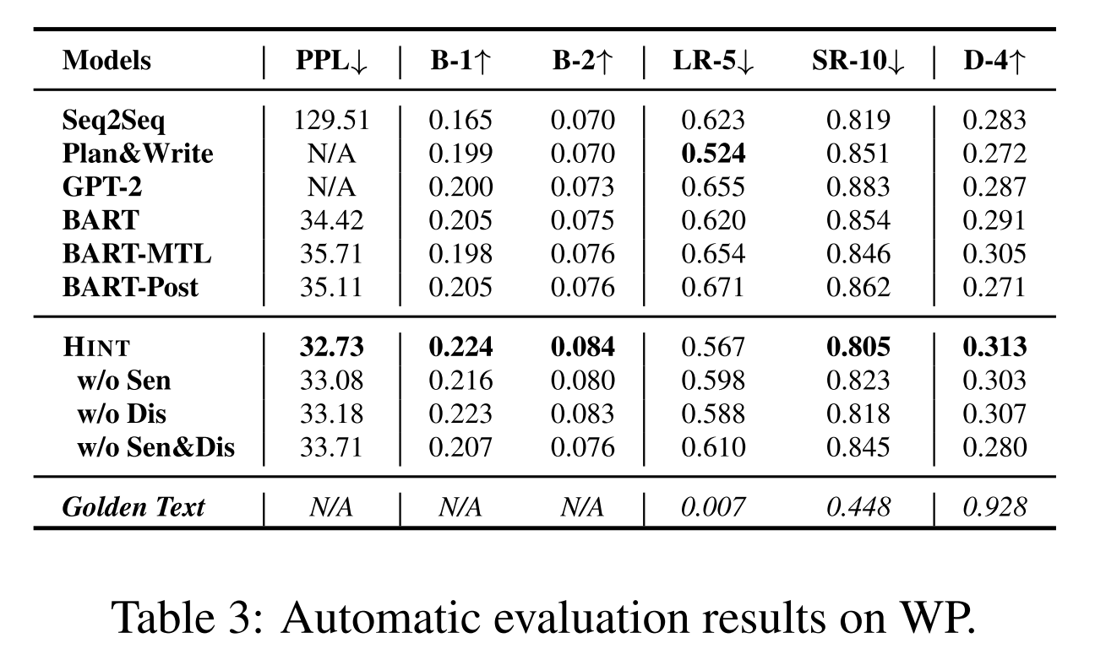
Experiment

Slide 13
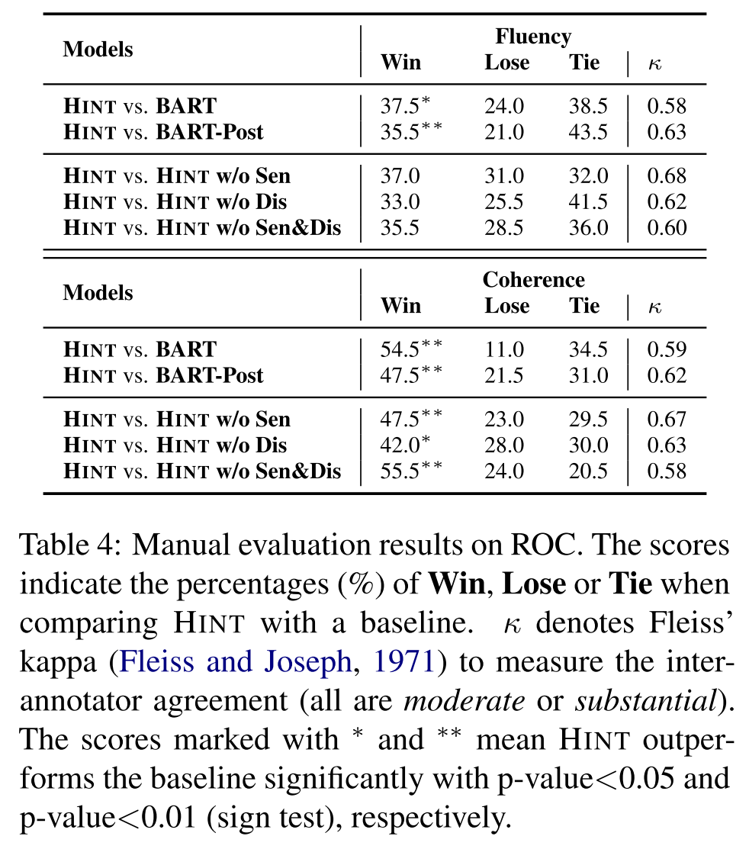
Experiment

Slide 14
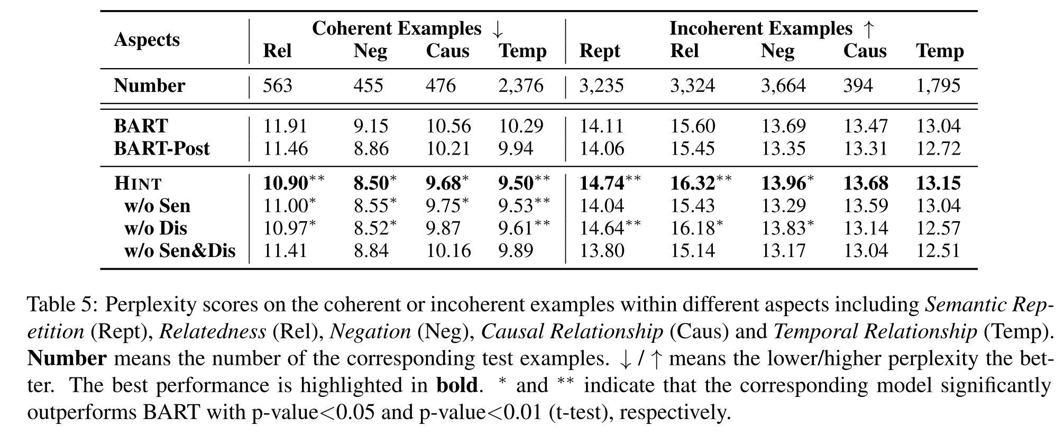
Experiment

Slide 15
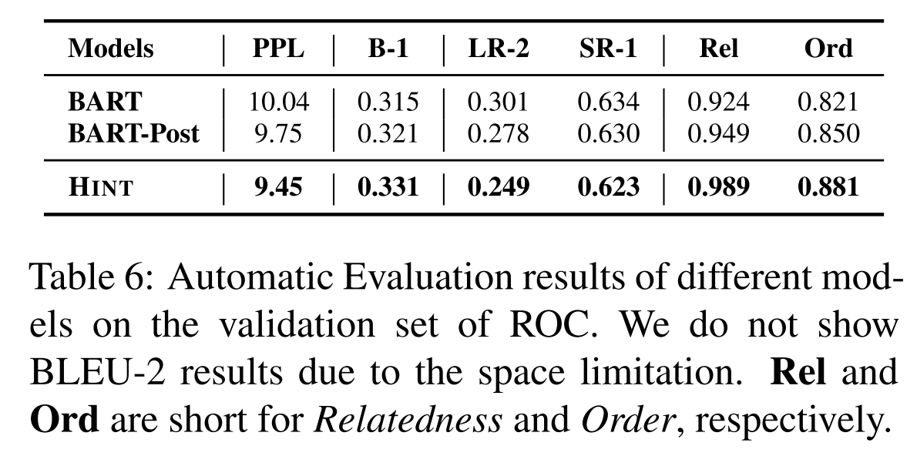
Experiment

Slide 16
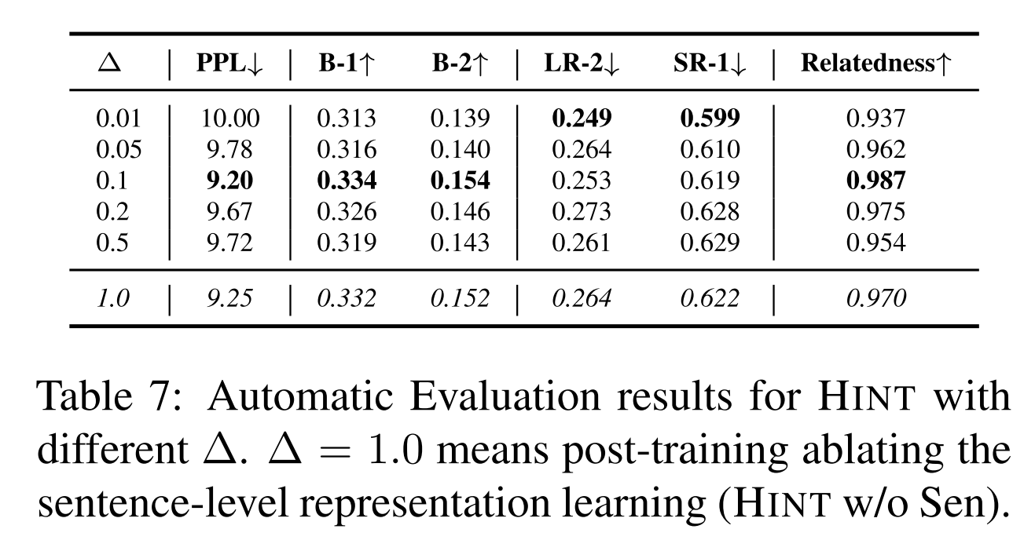
Experiment

